Slide 1

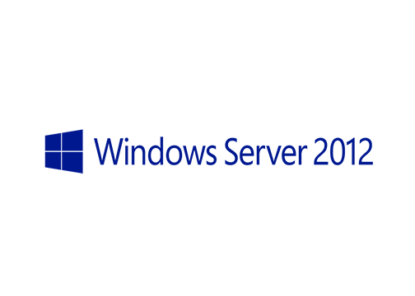
MegaSeries
Windows Server with a GUI, Server Core and Minimal Server Interface

Slide 2
Deployment Options
Server Core (the default option)
Server with a GUI
Powershell now installed by default on Server Core
More roles and features are working now on Server Core

Slide 3
Configuration levels
The classic server deployment with all GUI tools and Windows/Internet explorer
Server with a GUI

Slide 4
Configuration levels
The classic server deployment with all GUI tools and Windows/Internet explorer
Classic server without Windows/Internet explorer and associated files
Server with a GUI
Minimal Server Interface

Slide 5
Configuration levels
The classic server deployment with all GUI tools and Windows/Internet explorer
Classic server without Windows/Internet explorer and associated files
You can go from Server Core to any of the other 2 levels and vice-versa with only a restart
Server with a GUI
Minimal Server Interface
Server Core

Slide 6
https://www.youtube.com/channel/UCcZ-jLbPwNr8E_v9-65n8Iw https://github.com/itknowledge4

